Slide 1
Sentiment analysis
Restaurant review
Submitted by: Biplab Shakya (200577549)
Anup Regmi (200576708)

Slide 2
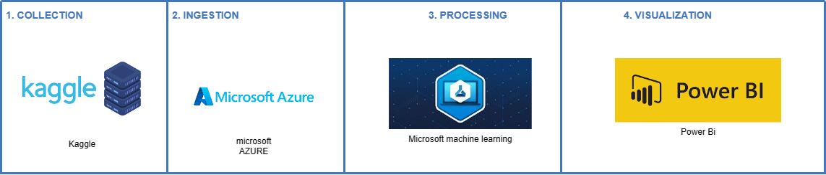
Project architecture
For the collection of data, we preferred taking the already existing data from the well known web source called kaggle.
Then, for the ingestion we used Microsoft Azure
For the further processing of the data we used Microsoft machine learning
Then lastly for the visualization we used Power Bi

Slide 3


Group work
Biplab Shakya
Anup Regmi
200577549
200576708

Slide 4
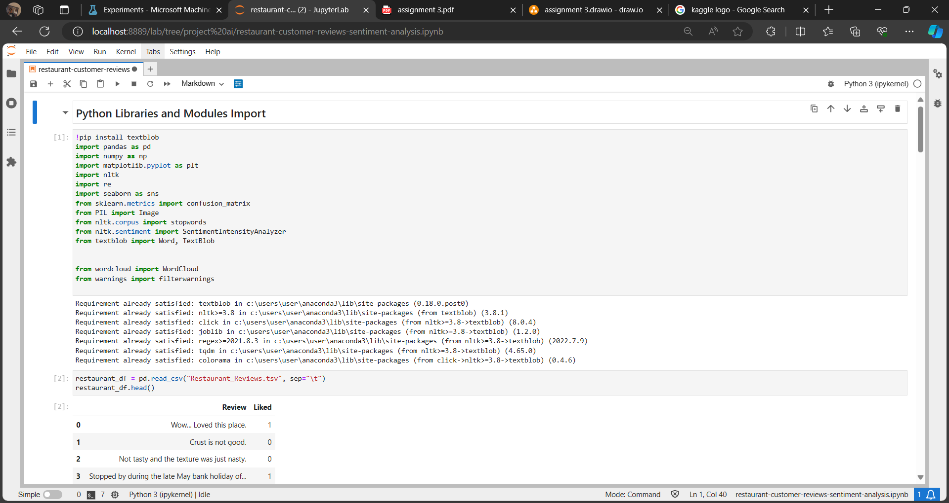
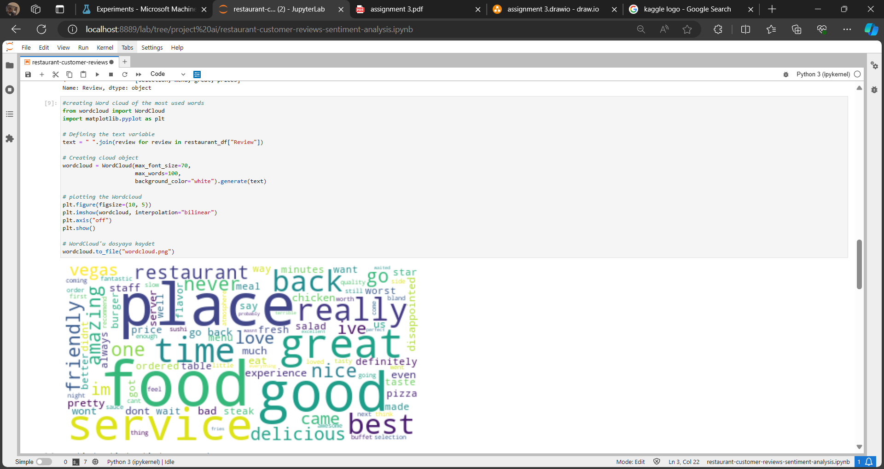
Code & Library used
The platform we used is called JupyterLab and used Python code for the execution

Slide 5
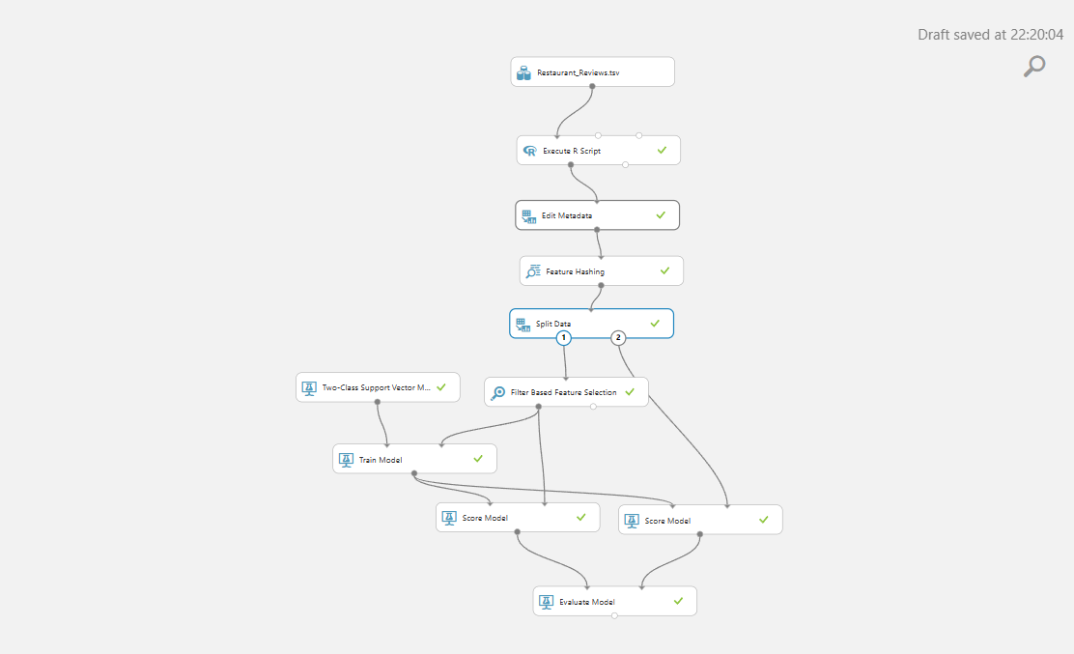
Project screenshots
Sentimental analysis done on Microsoft Machine Learning studio

Slide 6
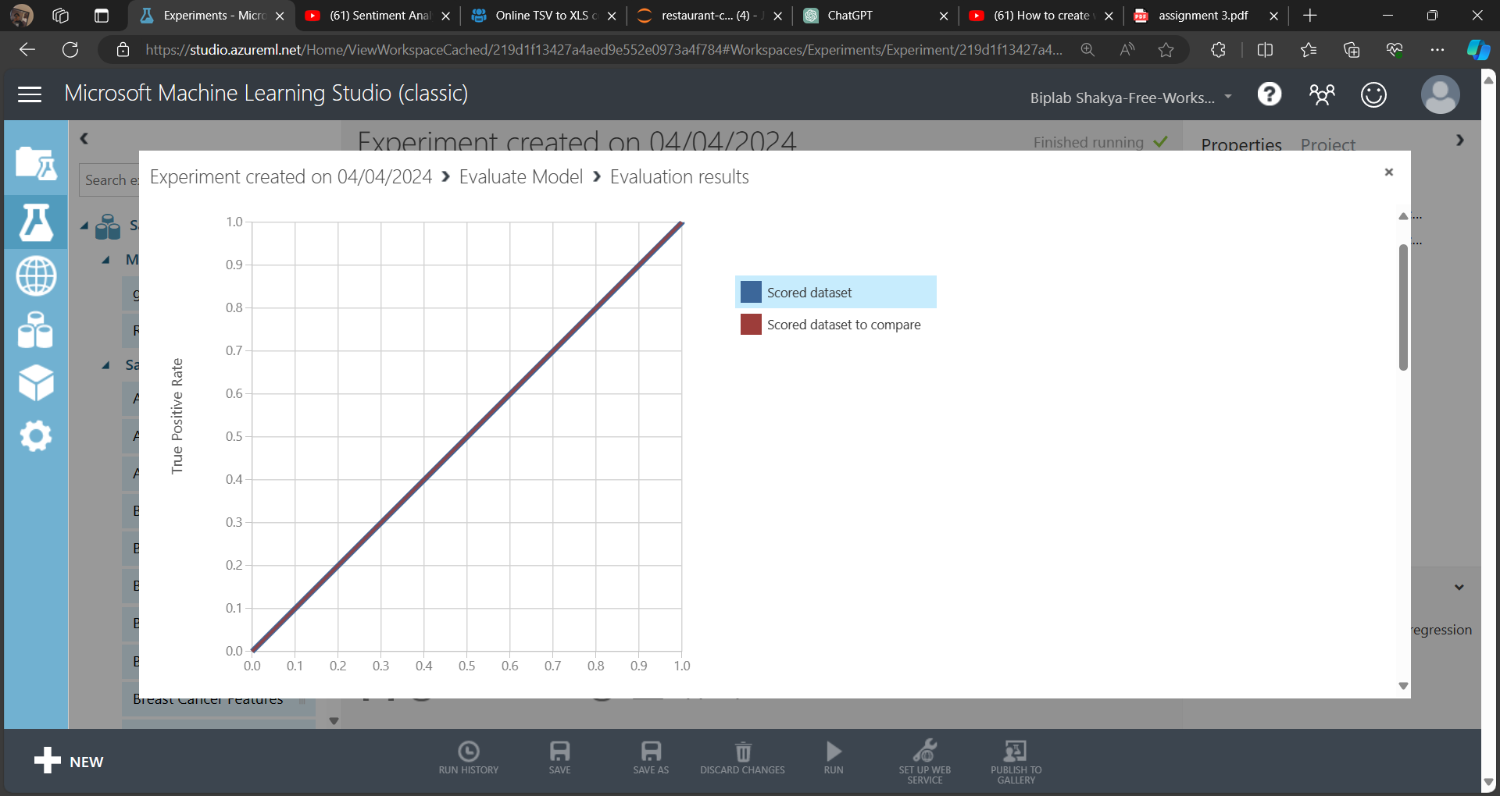
Project screenshots
Visual representation of output on Microsoft Machine Learning studio

Slide 7
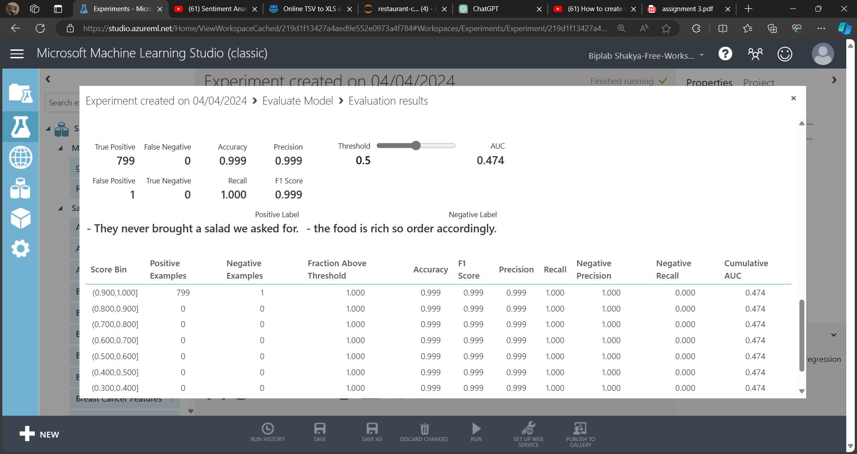
Project screenshots
Evaluation result on Microsoft Machine Learning Studio

Slide 8
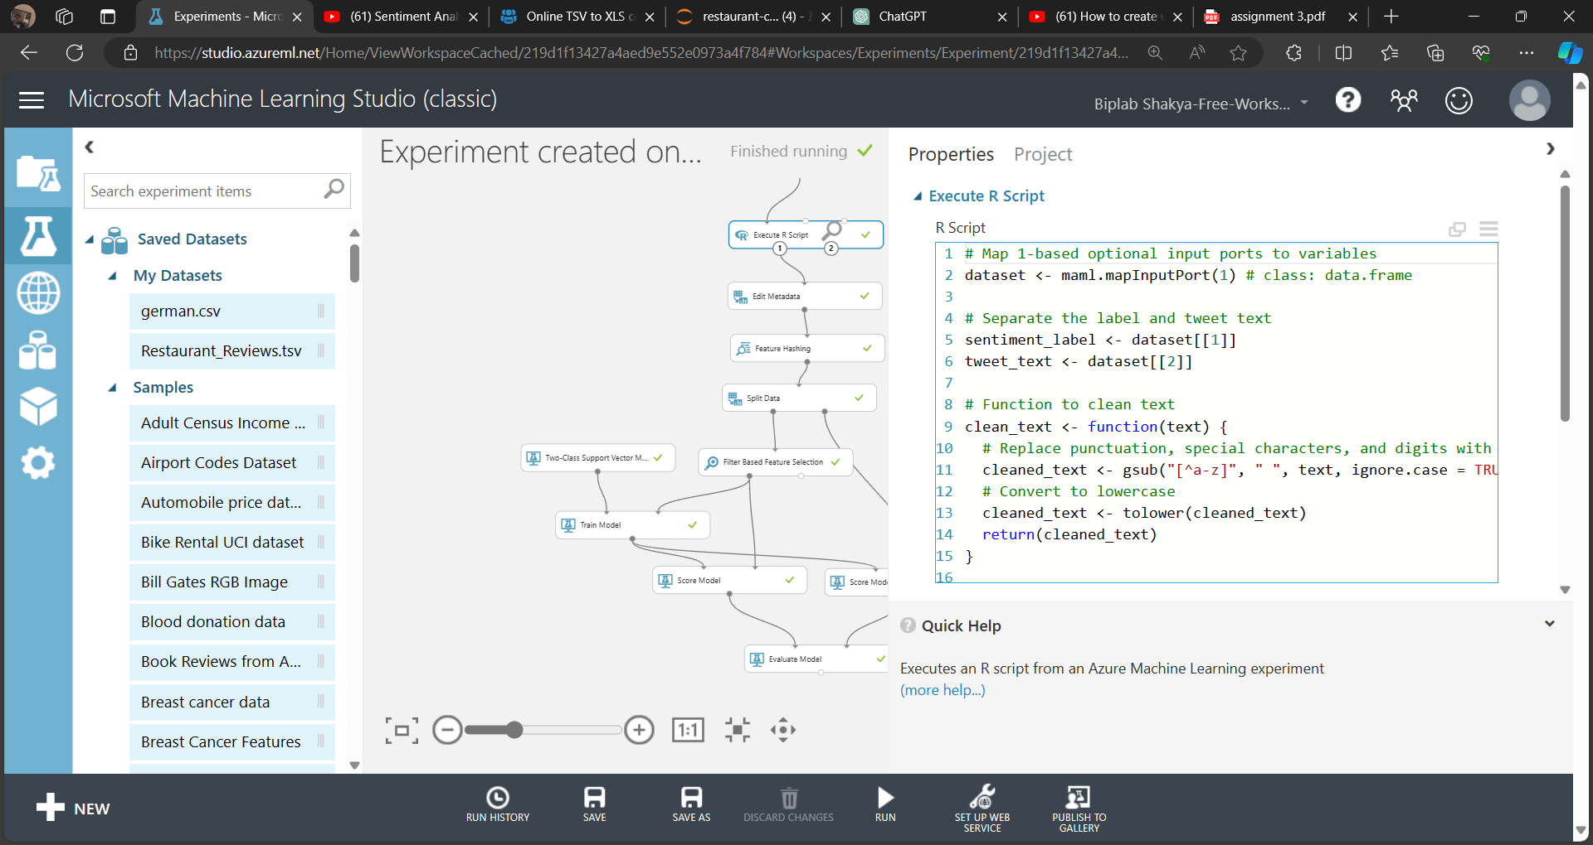
Project screenshots
Manual coding for removing punctuation marks, digits and converting them into lower case.

Slide 9
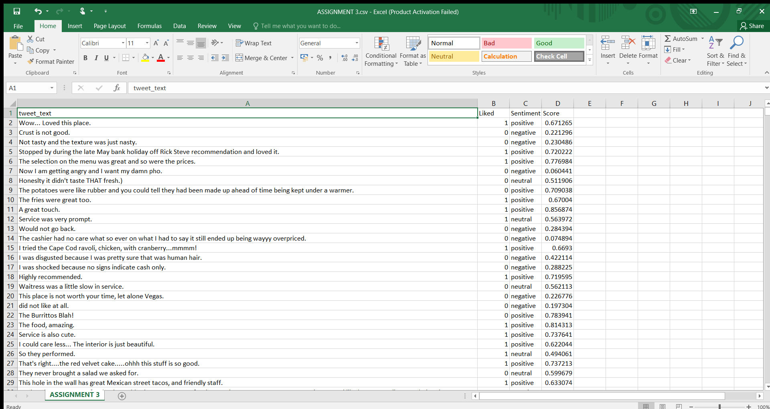
Project screenshots (excel)
Using MS Excel for sentiment analysis with the sentiment and scores as an output

Slide 10
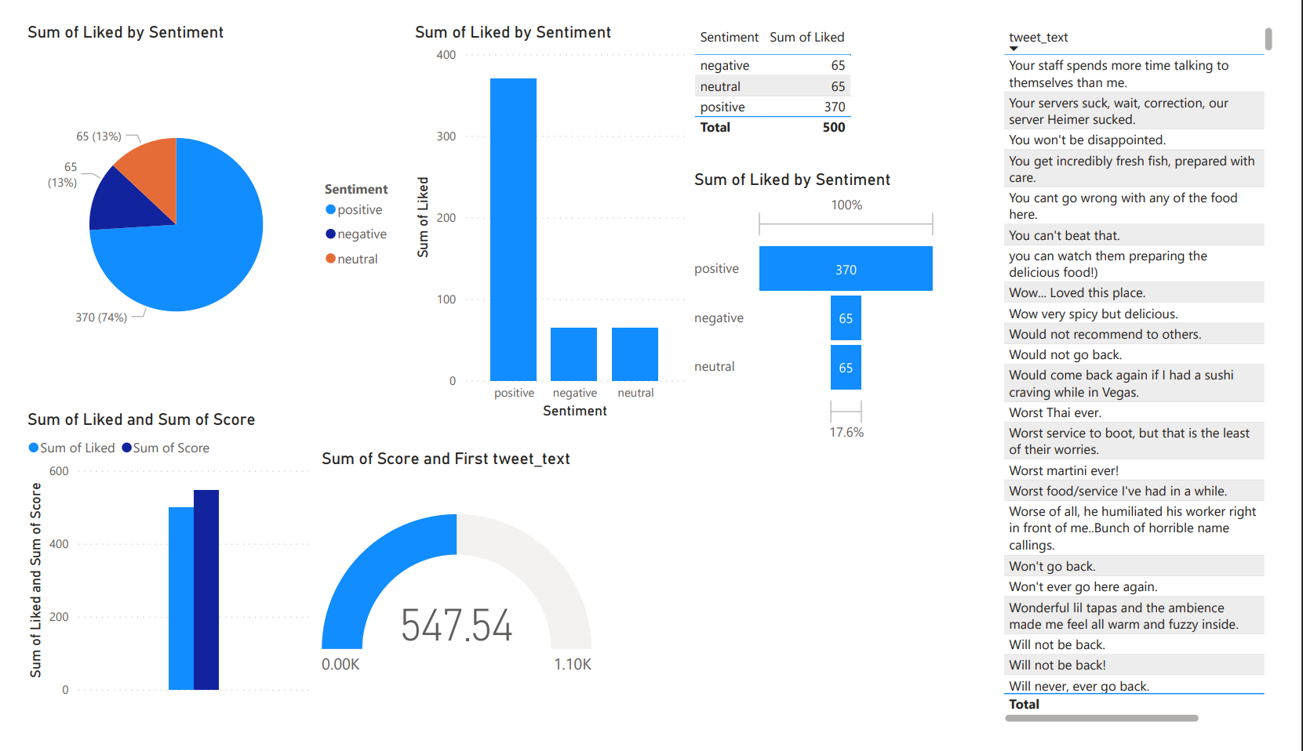
Data Visualization using power bi
The above figure shows the data of restaurant review

Slide 11
Thank you

